Slide 1
INTRODUCTION TO WEB DEVELOPMENT - SESSION 3
Dragan Gelevski - Gdragan6@gmail.com

Slide 2
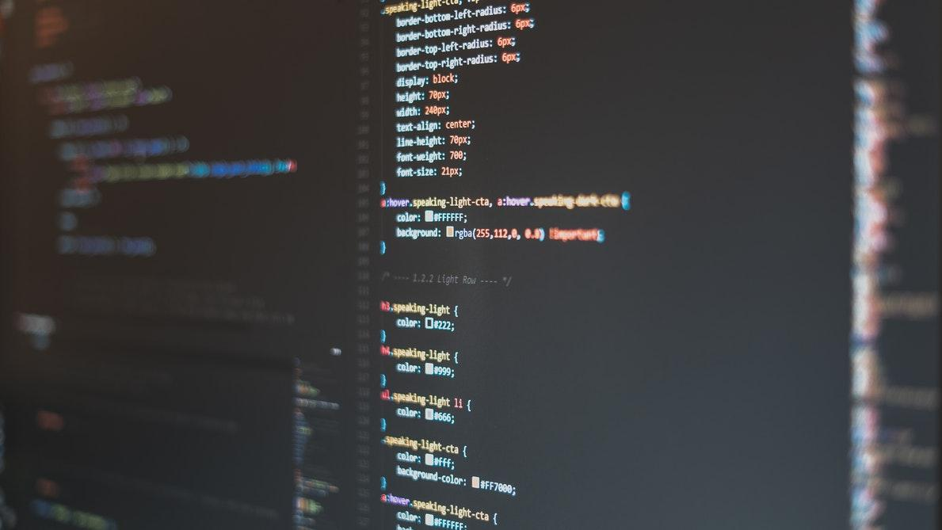
How can we think like programmers?
@SEDC 2018-2019

Slide 3


PROGRAMMERS MINDSET
A willingness to experiment
An acceptance that you will make mistakes
An understanding that your improvement will not be linear
@SEDC 2018-2019

Slide 4
A PROBLEM
The problem:
I need to know what the sum of two numbers is accurately. I need this to work with different numbers, numbers that will be entered through some input
@SEDC 2018-2019

Slide 5
A PSEUDOCODE SOLUTION
Person inputs two numbers in the program. The program sums the first and the second number and adds them in a result. The program returns the result to the user.
@SEDC 2018-2019

Slide 6
ANOTHER PSEUDOCODE SOLUTION
Input => number1, number2
result = number1 + number2
Output => result
@SEDC 2018-2019

Slide 7
PSEUDOCODE BUT I’VE SEEN SOME CODE
Begin {
a = input();
b = input();
result = a + b;
return result;
}
@SEDC 2018-2019

Slide 8
A FLOWCHART SOLUTION
Start
number1
number2
result = number1 + number2
PRINT result
End
@SEDC 2018-2019

Slide 9

SOME PROBLEMS PROGRAMMERS FACE
Naming things is really hard
Finding mistakes and broken things ( bugs )
Fixing mistakes and broken things ( bugs )
@SEDC 2018-2019

Slide 10
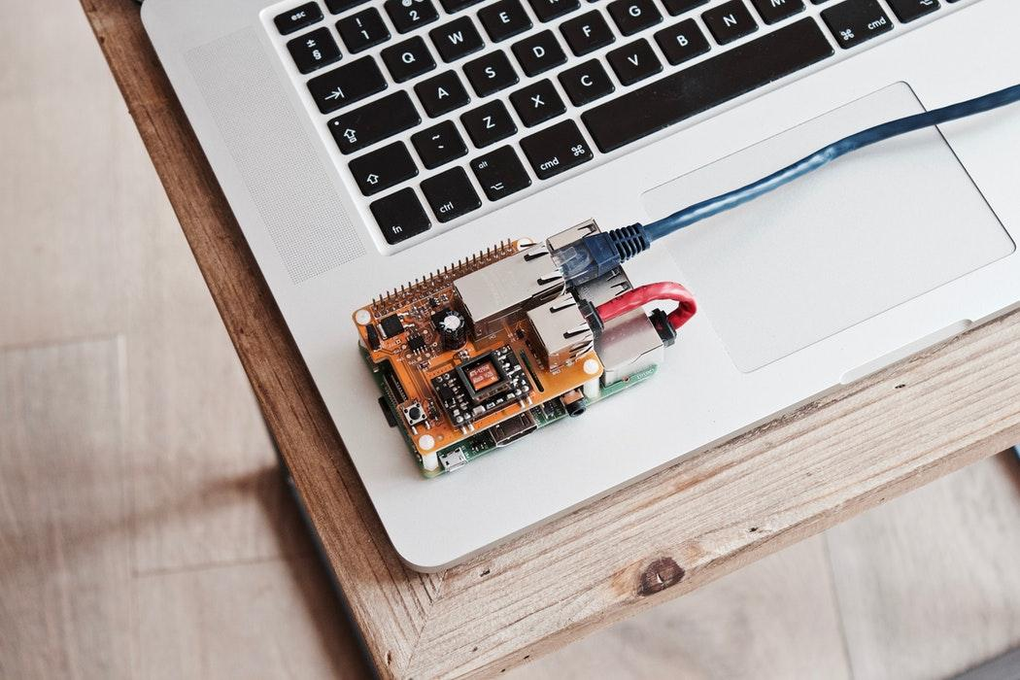
Programming methodologies?
@SEDC 2018-2019

Slide 11
SIMPLE TASK
Write a simple program that makes a dollar/denar conversion
Time to complete: 10 - 15 minutes
@SEDC 2018-2019

Slide 12
SIMPLE TASK ATTEMPT no.1
Input value and currency
Calculate the conversion rate
Output a converted value
@SEDC 2018-2019

Slide 13
SIMPLE TASK ATTEMPT no.2
Input currencyAmmount and currencyType
Check if the currencyType is dollar or denar
Multiply or Divide to the appropriate conversion rate
Output a convertedCurrencyAmmount value
@SEDC 2018-2019

Slide 14
SIMPLE TASK ATTEMPT no.3
Input currencyAmmount(The ammount of money to be converted)and currencyType(Dollar or Denar)
Check if the currencyType is dollar or denar
Multiply currencyAmmount with denarRate(53.34) if the currencyType is dollar
Divide currencyAmmount with dollarRate(0.019) if the currencyType is denar
Output a convertedCurrencyAmmount value
@SEDC 2018-2019

Slide 15
Start
currencyAmmount
currencyType
currencyType = Denar/Dollar
NO
YES
currencyType = Dollar
YES
NO
currencyAmmount * denarRate
currencyAmmount / dollarRate
End

Slide 16
MAKING DECISIONS
We have things called logical expressions
They can only be true or false
Their value can always be determined
“If” can describe a condition we want to test
We can make decision based on its outcome
We can take different action based on the value of the condition
@SEDC 2018-2019

Slide 17
IF - THEN - ELSE STRUCTURE
If condition then
true alternative action
else
false alternative action
End-if
If first > second then
print “First is larger”
else
print “First is not larger”
End-if
@SEDC 2018-2019

Slide 18
Start
first,
second
YES
first > second
NO
Print “First is larger”
Print “First is not larger”
End

Slide 19
NESTED IF - THEN - ELSE STRUCTURE
If first > second then
print “First is bigger”
else
If first < second then
print “Second is bigger”
else
print “They are equal”
End-if
End-if
@SEDC 2018-2019

Slide 20
MAKING DECISIONS
Operator | Description
> | Greater than
< | Less than
= | Equal to
>= | Greater or equal to
<= | Less or equal to
!= | Not equal to
@SEDC 2018-2019

Slide 21
TASK I
Write an algorithm to determine a student’s final grade and indicate whether it is passing or failing
The final grade is calculated as the average of four marks
Time to complete: 10 - 15 minutes
@SEDC 2018-2019
Notes:
ASK QUESTIONS ABOUT PASS FAIL MARK
GRADE 1-5
PASS 3

Slide 22
MAKING NON-BINARY DECISIONS
Sometimes we have more than two outcomes
Implemented very differently in different languages
Fortunately, very similar in C# and JavaScript
We can take different action based on the value of variable
@SEDC 2018-2019

Slide 23
IF - THEN - ELSE STRUCTURE
switch expression
case value1:
value1-statements
break
case value2:
value2-statements
break
…
default
default-statements
break
end-switch
switch day
case 0:
print “Monday”
break
case 1:
print “Tuesday”
break
…
default
print “No such day”
break
end-switch
@SEDC 2018-2019

Slide 24
Start
day
day
0
1
2
4
5
6
default
3
“Monday”
“Wednesday”
“Friday”
“Sunday”
“Tuesday”
“Thursday”
“Saturday”
“No such day”
End

Slide 25
RUNNING CODE MORE THAN ONCE
Computers are great at repetitive work
If we can solve it logically from one step to the next, we can get the computer to do the repeating of the process
We can solve otherwise insolvably tedious problems easily
@SEDC 2018-2019

Slide 26
FOR STRUCTURE
for initial-expression; test-expression; loop-expression
loop-statements
end-for
var max = 0;
for var i=0; i<=20; i++
input number
if number > max
max = number
end-if
end-for
print max
@SEDC 2018-2019

Slide 27
Start
max = 0
i = 0
i <= 20
NO
max
End
YES
number
YES
Number > max
Max = number
NO
i++

Slide 28
COLLECTIONS
Computers are also great for working with repeatable data
Collections (lists, arrays) are a way of storing related data together, and easily accessing it as needed
Access is usually done with a numerical index
They indices are (almost always) zero-based
@SEDC 2018-2019

Slide 29
FOR STRUCTURE
var collection = [ item1, item2, item3… ]
collection[0] = newItem
var students = [ … ];
for var i=0; i<students.length; i++
if students[i].length != 0
print student[ i ]
end-if
end-for
@SEDC 2018-2019

Slide 30
Start
students = [ … ]
i = 0
i <= students.length
NO
End
YES
NO
Students[i].length != 0
YES
print students[i]
i++

Slide 31
TASK II
Let's program our way to CodeCombat!
https://codecombat.com/students?_cc=WaterFlyStop
Code: WaterFlyStop
@SEDC 2018-2019

Slide 32

Time for questions!
@SEDC 2018-2019

